Slide 2
Model of Multiprocessor and Distributed Systems
Tightly Coupled processor…
Centrally controlled scheduler /Dispatcher to keep global and information workload cost low. processors works coherently (Synchronized)
Loosely Coupled:
Used in Distributed systems and Costly to keep global status workload information schedular on different processor may make resource access control decesion independently hence may be incoherent.

Slide 3
Identical Vs Hetrogeneous processors
Identical processors….jobs can be interchangeably allotted
Heterogeneous processors: Not related to each other and functionally different

Slide 4
End to End Jobs and task
Jobs/tasks may have precedence constraints in contrast to independent jobs which have their own release time and deadlines.
A system function is often defined with set of related jobs and may have precedence constraints which task graph may be chain.
Timing constraints of such task are imposed on the jobs at the two end of the task we call them ened to end release and deadline.A task that has an End to End releaase and dead line is and END to END task.

Slide 5
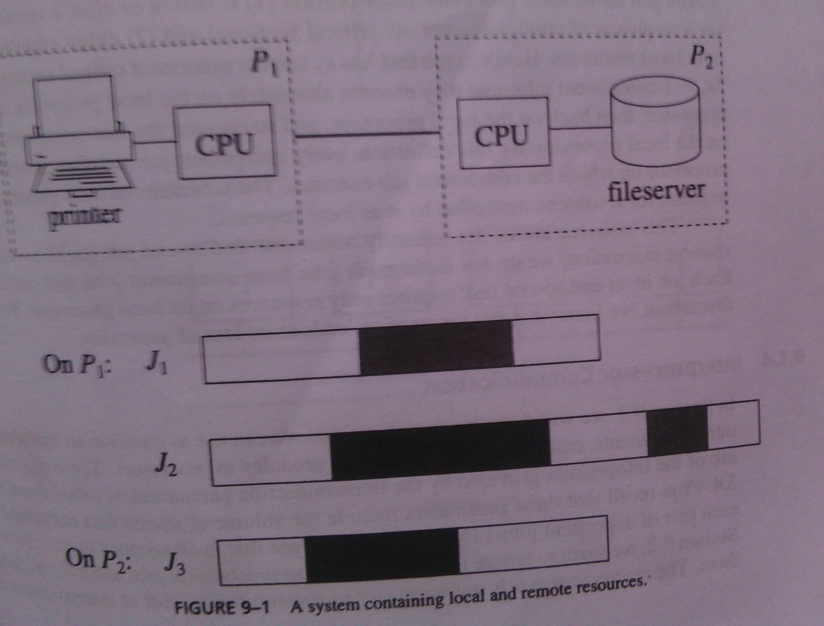
Local and remote Resources
J1 and J2 are local task to processor P1, where as J3 is Local to Processor P2.however J2 requires global resource which is local to Processor p2 hence it acess it on behalf of P2.File server is global resource .

Slide 6
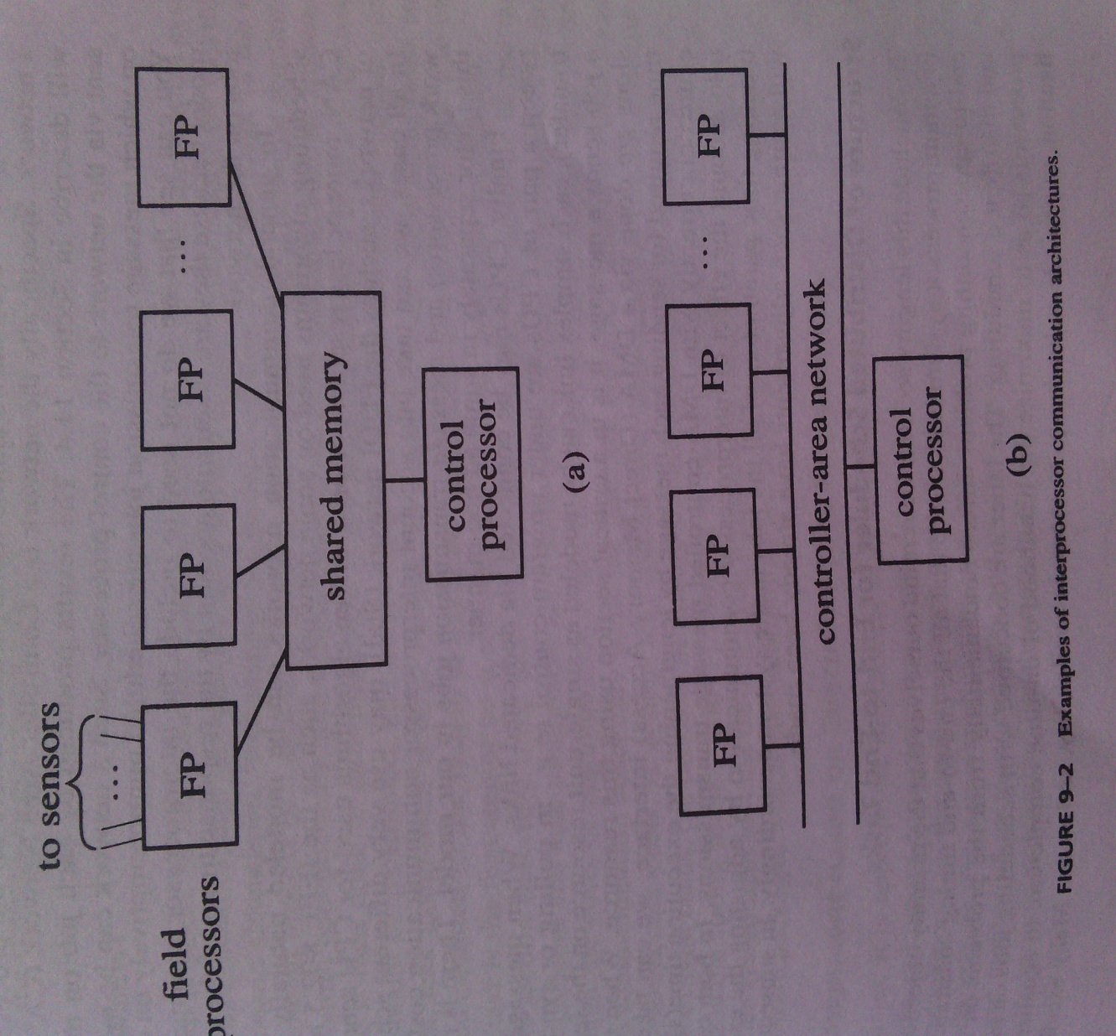
Interprocessor communication

Slide 7
Task assignment
Most current Hard real time systems are static, application system is partitioned in to modules,and modules are assigned and bound to processors. We call this step Task assignment. often Task assignment is done offline. how many processors of each type are Needed ,how the task should be partitioned, and on which processor each application module Executes.
For online task assignment to decide where to execute(which processor) is the first step in acceptance test.

Slide 8
Task assignment based on execution time requirements. Simple Bin Packing Formulation.
We are given the utilization of n periodic task, we are asked to partion the system in to modules in such away that the task in each mdule are schedulable by themselves in the processor according to uniprocessor scheduling algorithm of a given class. We say assignment requires m processors if it partitons the n task in to m module. The quality of task assignment is measured by the no of processor required by the assignment.
Eg we want to schedule n indepenent ,preemptable periodic task,according to EDF, the total utilization of all the tasks exceeds 1, so it is impossible to feasibly schedule them on one processor.to determine that how to partition the task so that they are schedulable on a minimum no of processor.we know that the if the total utilization is no greater than 1 it is schedulable.we may constrain the total utilization of all task to be some value U~<1 so tat spare capacity can be alloted to some aperiodic and sporadic job

Slide 9
It is straightforward to formulate this task assignment problem as the simple Bin packing problem.
The size of all the bins are U~ and size of the items to be packed in bins are Ui=i=1,2,…n.
No of bins required to pack all the itmes are the no of processors and items that are packed in each bins are the task. we can use optimal or suboptimal packing algorithms,

Slide 10
Simple uniform size bin packing problem eg,Using Densities of task,partioninig rate monotonically,
Heuristic algorithm such as First Fit algorithm task are assigned one by one in turn in arbitrary order.the first task is assigned to processor P1.after some task i-1 task is assigned the ith task is assigned to processor Pkif total utilization of Ti and task already assigned to Pk is equal to or less than U~.
Other algorithm is varible size bin packing formulation:Rate Mono.First Fit RMFF and RMST Rate Mono.Small task,RMGT( rate Mono.general task)

Slide 11
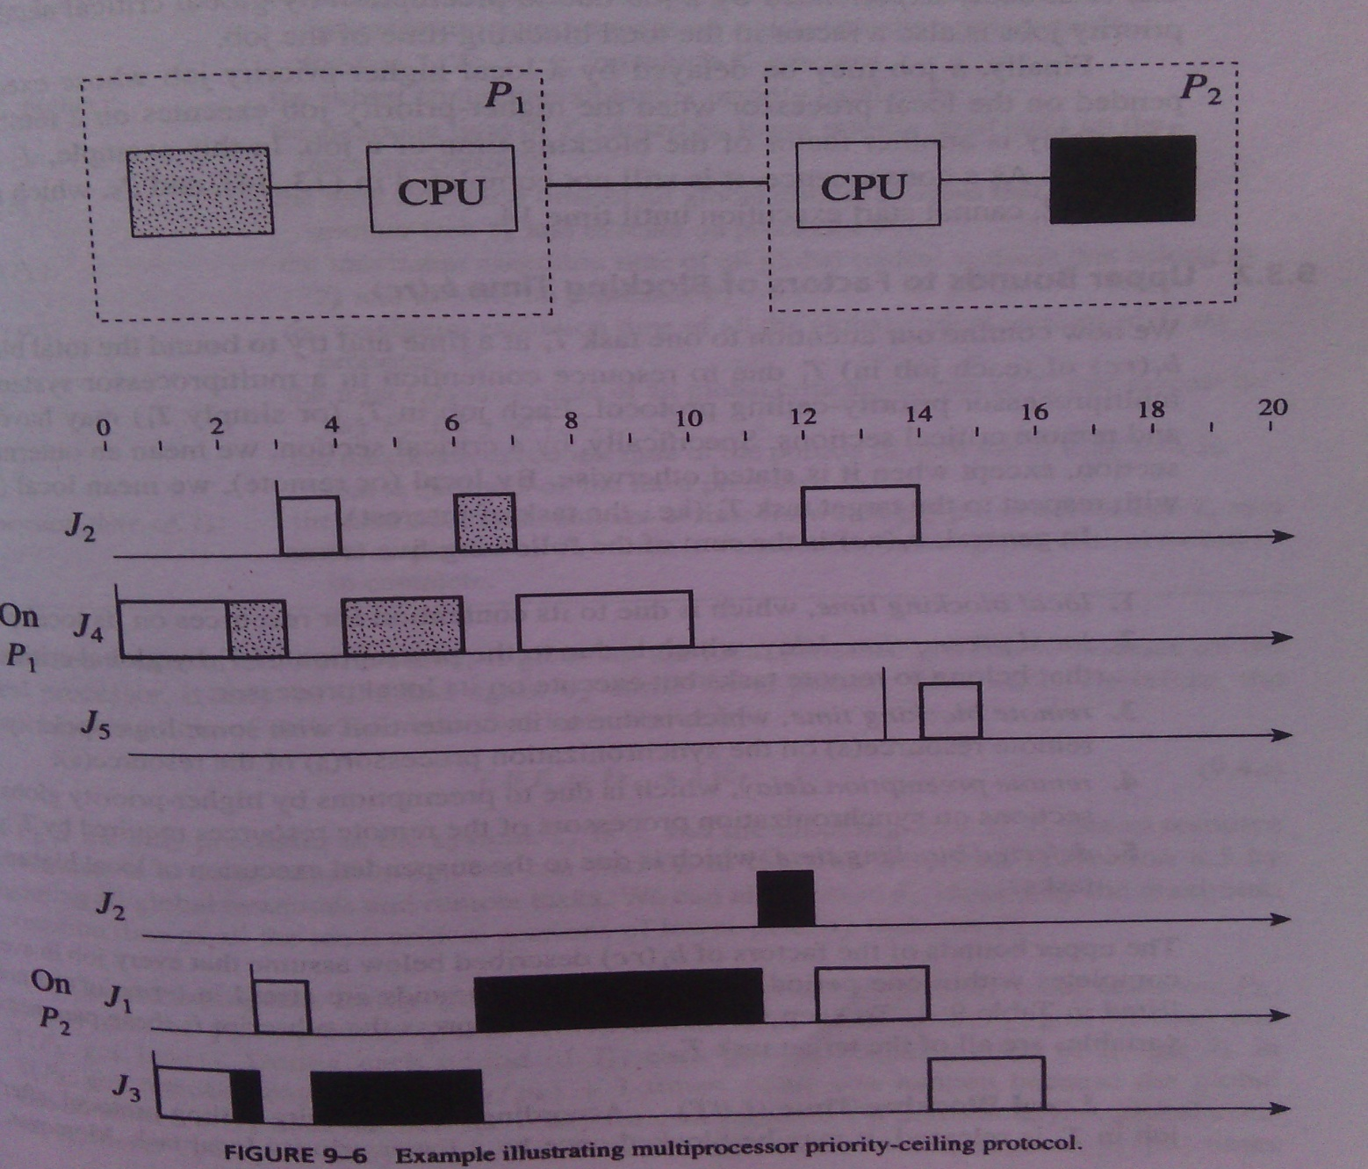
Multi processor priority ceiling protocol and Blocking time due to resource contention

Slide 12
Elements of scheduling algorithm for end to end periodic task.
Two essential components of any end to end scheduling schemes are
Protocols for synchronizing the execution of sibling subtask on different processors so that precedence constrained on subtask are mainted.
Algorithm for scheduling subtask on each processor.

Slide 13
Interprocessor synchronization protocol
Greedy Synchroniztion protocol used in non real time systems eg vieo communication as soon as frame is compressed transmission subtask over a network is made ready.simple and doesnot require global clock synchronization.only global information required is uplink stream and downlink stream processor ideneties.
Non Greedy :schedular may delay the relese of its sibling subtask even though its immediate predecessor has already completed.

Slide 14
End to End task in heterogeneous systems.
All but the Simplest embedded system contains different types of processor,typically variety of approaches are used to schedule task on these processors.
Schedular on every processor uses real time scheduling algorithm.

